Slide 1
The Beginning of My Journey
CEIS101 Final Course Project
November-December 2024
Gregory Holman
Prof. /Susan Nachawati/

Slide 2
Introduction
The project I done was designing a functioning home security system using online resources to set up a board, wire it, and code the functions of the System.
The objective was to design a functioning Home Security system with an alarm as well as functioning lights/ motion and distance sensors.
The tool I used in this project was the Circuit Design tool in TinkerCad.

Slide 3
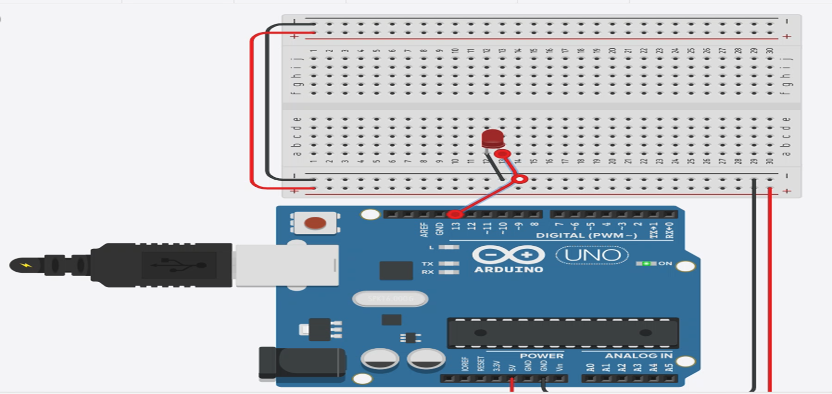
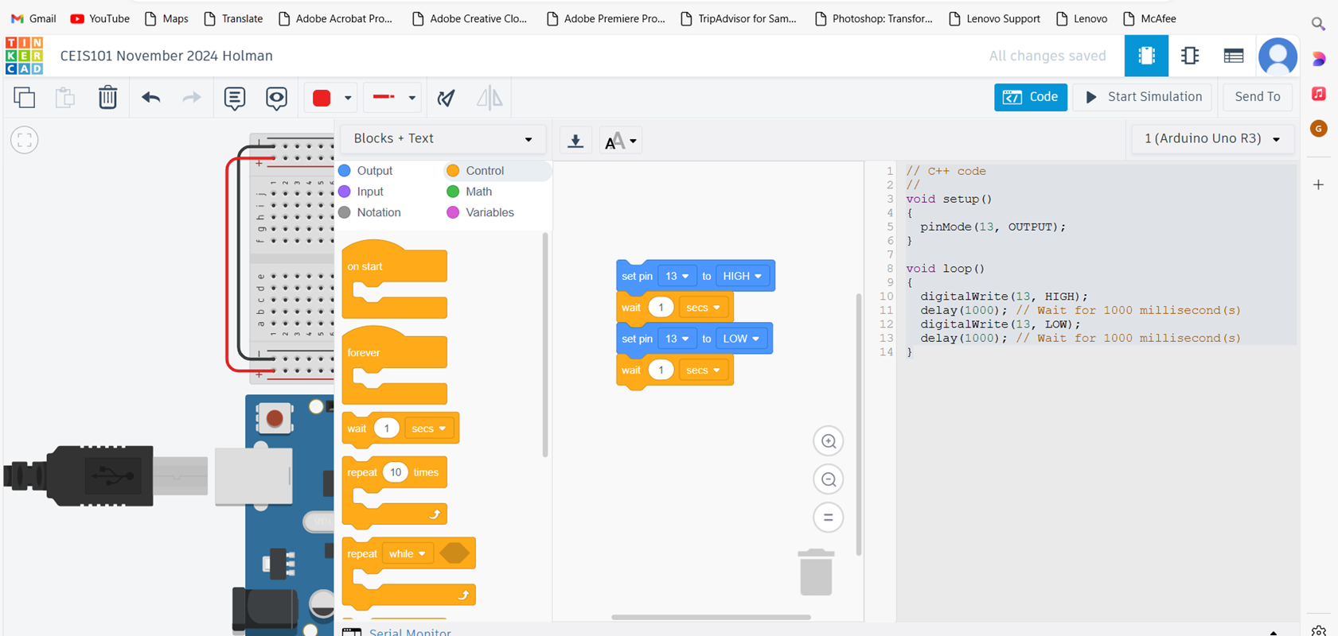
Project Slide (Circuit Simulation)

Slide 4
Circuit Simulation Description
Pictured in the previous slide are the code and the circuit board for my first project in TinkerCad.
Wired to the Circuit Board is a Simple Red LED that I grounded and wired into the breadboard.
I then used the code to program the LED to turn on and off when the bread board was powered.

Slide 5
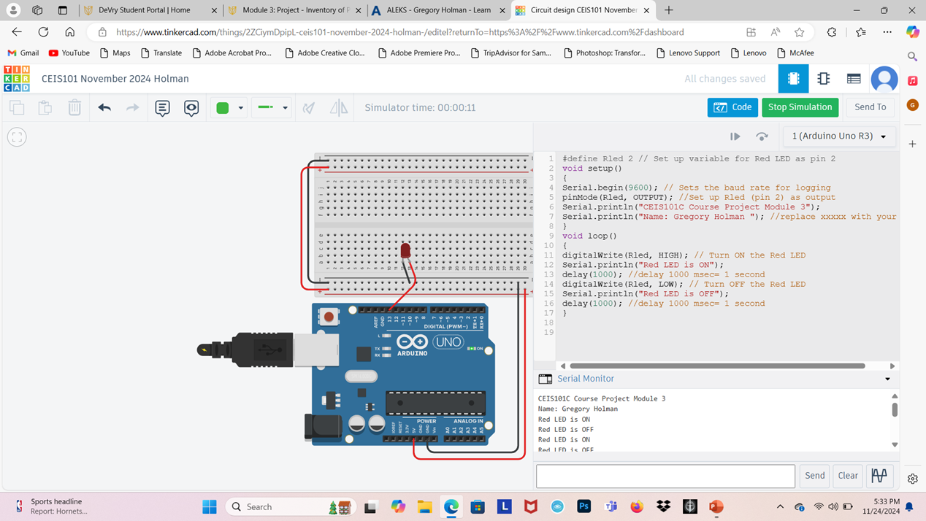
Project Slide ( Circuit Building/Displaying a Message)

Slide 6
Project Description
The previous slide is a picture of the finished Circuit Board wired with a Red LED, the code used to cause the light to flash on and off when powered, and the Serial Monitor that displayed my name whenever I would run the simulation.

Slide 7
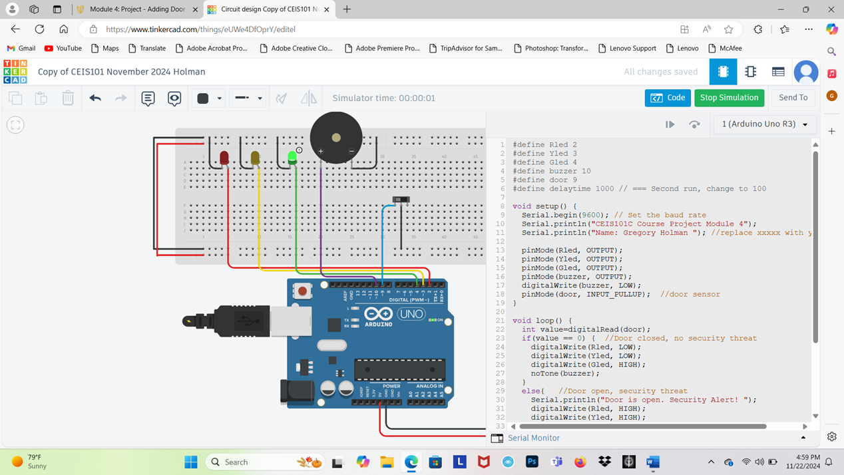
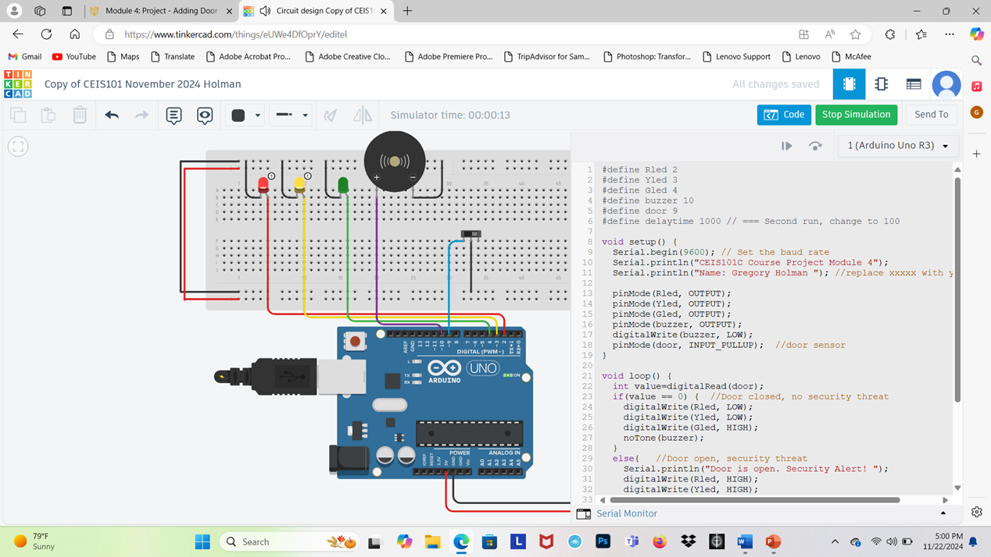
Project Slide (Adding Door Sensor to Security System)

Slide 8
Project Description
The previous slide shows the Circuit Board and Code that I used to Switch the color of the powered LED when a door was closed or opened using a door sensor wired into the bread board.

Slide 9
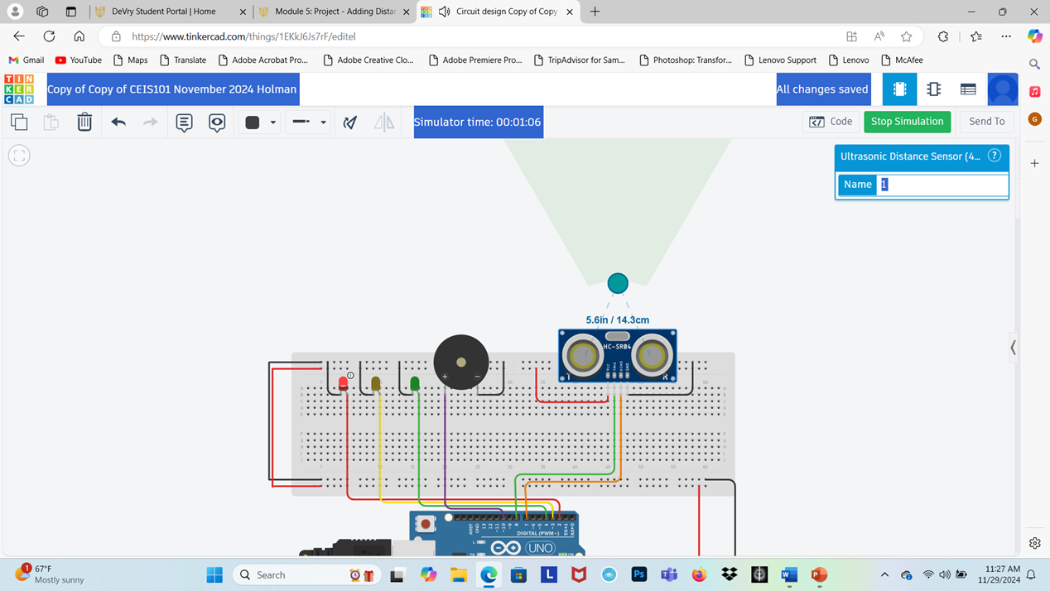


Project Slide (Adding Distance Sensor and Conducting Data Analysis)

Slide 10
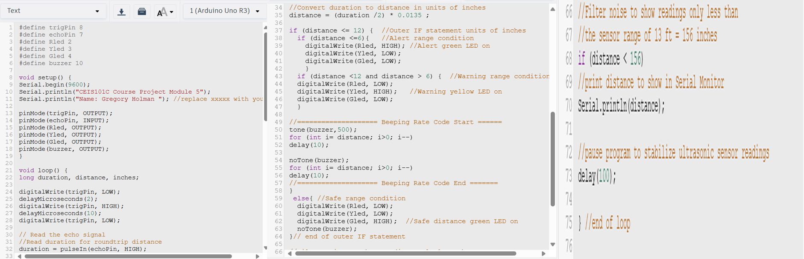
Code For Project

Slide 11
Project Description
Attached in the First slide of this section, is the Circuit Board Lighting LEDs up based on proximity of something to the Proximity Sensor installed, if the object got too close, an alarm would sound.
The second slide in this section shows the lines of code that I used to program the sensor and alarm to light and sound.

Slide 12
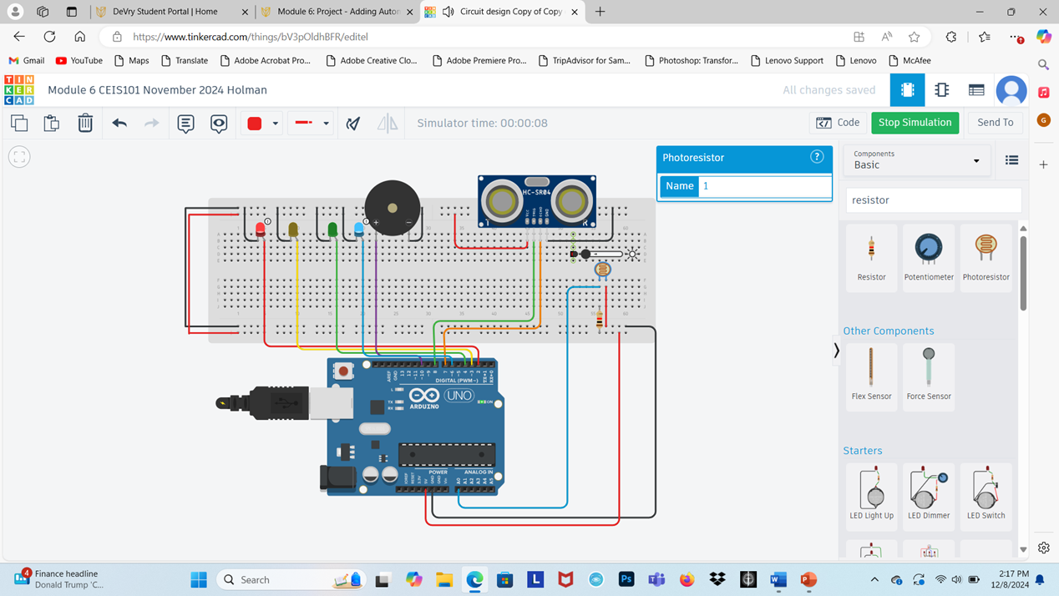

Project Slide (Adding Automated Light)

Slide 13
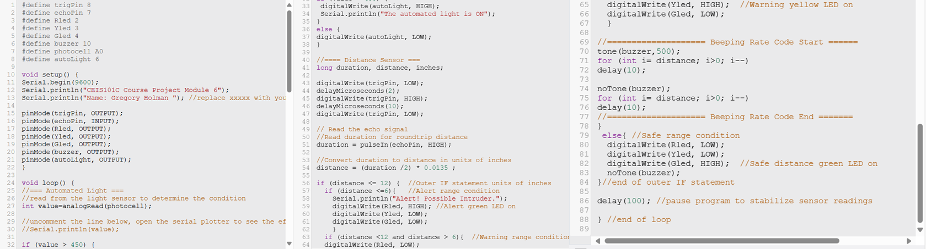
Project Code for Automated Light

Slide 14
Project Description
In slide one, I added a Photoresistor and sensors to add an automated light to my smart home security System.
In the second slide, I included all of the code used to cause the light to turn off and on.

Slide 15
Challenges/Lessons Learned
One of the biggest challenges I faced in this project was simply inexperience. I began this class with only a basic knowledge of coding/ programming anything.
I overcame the challenges I faced simply by learning what it was I needed to do, following the step-by-step instructions that were given to me to the letter, and fixing any mistakes I needed to along the way.
The lessons I learned throughout this course was that it’s a lot simpler to make a system for yourself with the right resources and that I can do anything I put my mind to if I try.

Slide 16
Career Skills
The skills I learned for my career field are programming and coding. I’m pursuing a degree in Software Development, and this class helped a lot.
The competencies that will help me get a foot in the door for my career field is the bit of programming I learned in this class and I’m also learning all of the different languages of code to help expand my portfolio.

Slide 17
Conclusion
This Class taught me many things more than just how to design a smart security system for a home. It taught me all the things that I never would have learned without beginning this career field, as well as helped me get an idea of one of the many things I could do with my degree. I enjoyed everything that I learned, and I see myself using the knowledge from this class for a very long time.

Slide 18
References
The resources used for this class was my personal laptop and TinkerCads Circuit Building Tool

